Slide 1
Tutorial 6: Recurrent Neural Networks and LSTM
097215 - Natural Language Processing – spring 2021
Eyal Ben-David Based on Slides by DOR Zohar and Nadav Oved

Slide 2
Agenda
Sequential Data
Fully Connected Neural Networks
Recurrent Neural Networks (RNN)
Backpropagation Through Time
Vanishing Gradient Problem
Long Short Term Memory (LSTM) Networks

Slide 3
Sequential Data
Some phenomena have a “sequential nature” to them
Each input is a sequence of samples, divided into “intervals” – x₁, x₂, ..., x_{n}
Sentences, stock prices, EEG signals etc.
We need models that capture sequential dependencies in data over time
Memory state
Example:
I know that many of my friends do not like this movie because it was too long and repetitive, but I didn’t.
Sequential models we have seen so far – Language Models, HMMs, Word2Vec.
Usually define the sequential dependence explicitly (f.e. Markov assumption, n-gram)

Slide 4
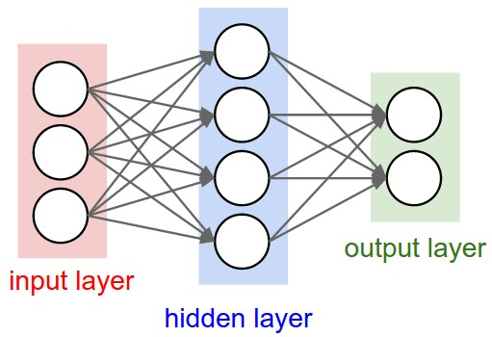
Fully Connected Neural Networks
Reminder:
Consist of stacked layers of interconnected “neurons”
Each layer multiplies the input vector by a weight matrix, then applies an activation function to its output
Fully Connected NNs do not “memorize” potential dependencies between samples
Each sample goes through the same computations, independently of the last input or output
Notes:
At end of slide jump to Word2Vec slides 34 - 38

Slide 5
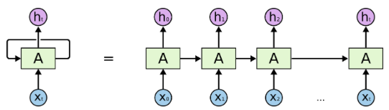
Recurrent Neural Networks
A neural network with a directed cycle.
The output of the network at time step t is part of the input of the network at time step t+1.
The cyclic connection serves as a memory state, updated at every time step given the last and current inputs.
This allows information to propagate through time, and implicitly serves as a form of “adaptive” dependence.

Slide 6
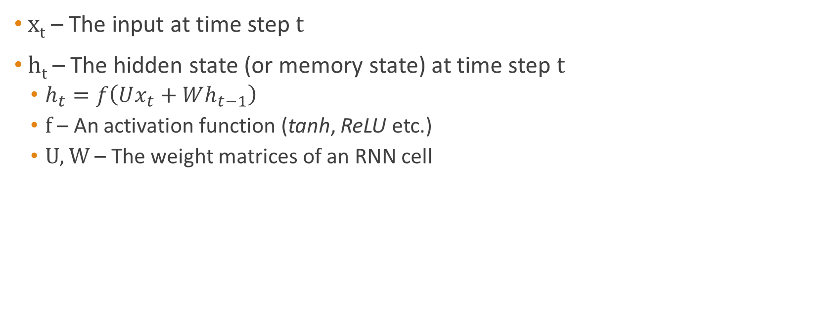
Recurrent Neural Networks
x_{t} – The input at time step t
h_{t} – The hidden state (or memory state) at time step t
$h_{t}=f\left(Ux_{t}+Wh_{t−1}\right)$
f – An activation function (tanh, ReLU etc.)
U, W – The weight matrices of an RNN cell
h₀
h₁
h₂
W
+
W
+
W
+
U
U
U
x₁
x₂
x₃

Slide 7
Recurrent Neural Networks
h_{t} can be used as an input to a fully connected neural network
Sequence tagging
Sequence Classification
DT
NN
VB
Fully Connected
Fully Connected
Fully Connected
Weights are shared across time steps
(Time Distributed)
h₀
h₁
h₂
W
+
W
+
W
+
U
U
U
x₁
x₂
x₃
Positive/Negative
Fully Connected
h₀
h₁
h₂
W
+
W
+
W
+
U
U
U
x₁
x₂
x₃

Slide 8
Stacked RNNs
We can stack RNNs to get a deeper, more complex model.
Intuitively, attempt to capture complex sequential dependencies.
Each output of a layer is the input of the layer above it.
h₀
h₁
h₂
W
+
W
+
W
+
U
U
U
h₀
h₁
h₂
W
+
W
+
W
+
U
U
U
x₁
x₂
x₃

Slide 9
What About Information From The Future?
Example 1: He said, "Teddy Bears are on sale".
Example 2: He said, "Teddy Roosevelt was a great president".

Slide 10
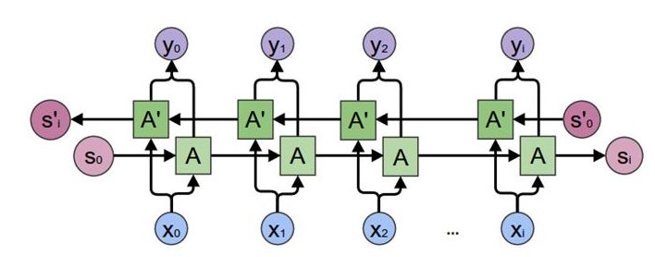
Bi-Directional RNNs
Information from “future” samples in the sequence can improve predictions
For example, DT and JJ are unlikely to appear before a verb
We can create two RNNs
Forward and Backward RNNs
Their outputs will be concatenated along the time axis

Slide 11
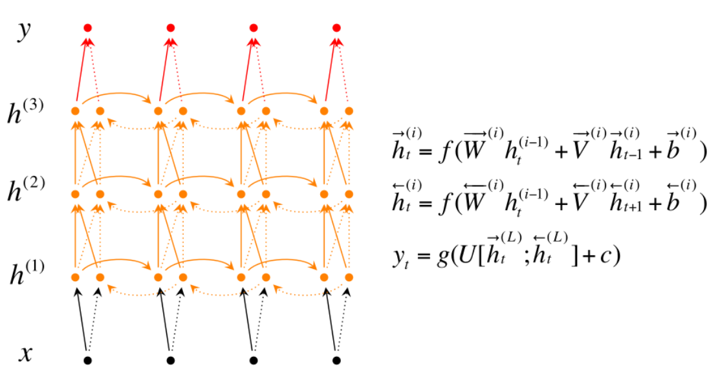
Stacked Bi-Directional RNNs
Diagram taken from Stanford NLP with Deep Learning

Slide 12
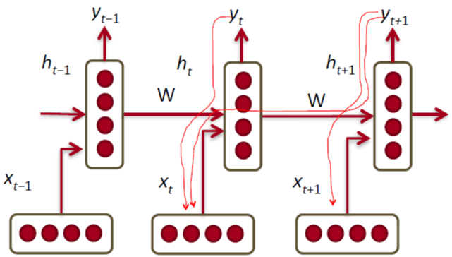
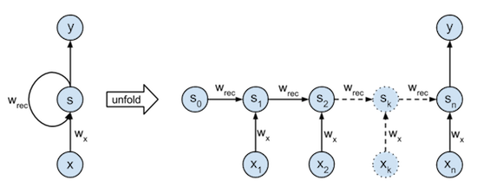
Back-Propagation Through Time (BPTT)
We can apply the back-propagation algorithm on any DAG network
For every batch of sequenced samples
The RNN is unfolded over time (usually a constant number of time steps, or the entire sequence)
Forward pass
Backward pass over the sum of losses over time
Weights of all RNN units are shared through time

Slide 13
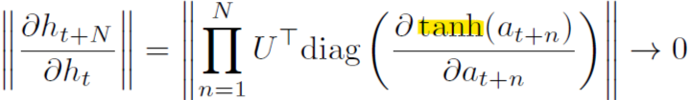
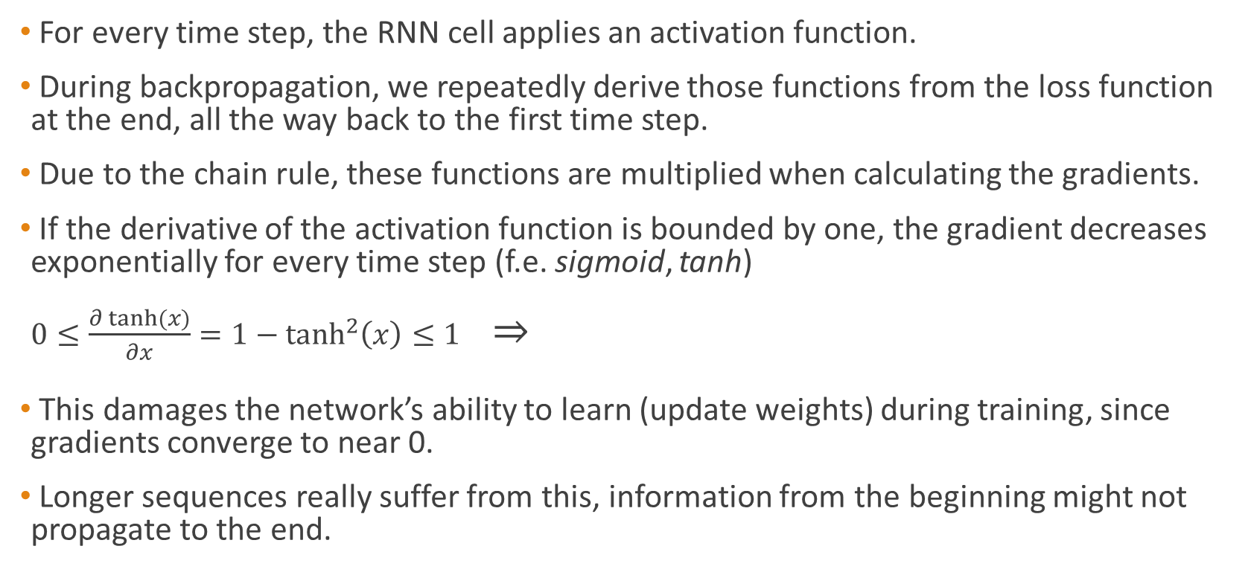
Vanishing Gradients
For every time step, the RNN cell applies an activation function.
During backpropagation, we repeatedly derive those functions from the loss function at the end, all the way back to the first time step.
Due to the chain rule, these functions are multiplied when calculating the gradients.
If the derivative of the activation function is bounded by one, the gradient decreases exponentially for every time step (f.e. sigmoid, tanh) $0≤\frac{∂\tanh{(x)}}{∂x}=1−\tanh^{2}\left(x\right)≤1$ ⇒
This damages the network’s ability to learn (update weights) during training, since gradients converge to near 0.
Longer sequences really suffer from this, information from the beginning might not propagate to the end.

Slide 14

Long Short Term Memory (LSTM)
The LSTM (Hochreiter & Schmidhuber, 1997) is an “upgraded” RNN cell
It alleviates the vanishing gradients problem, doesn’t fully solve it.
Employs 3 special internal (learned) gates, which control the current cell state and propagation of information dynamics along the cells in sequence:
Forget gate
Input gate
Output gate
Diagrams by Chris Olah: http://colah.github.io/posts/2015-08-Understanding-LSTMs/

Slide 15
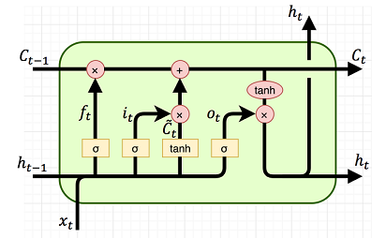
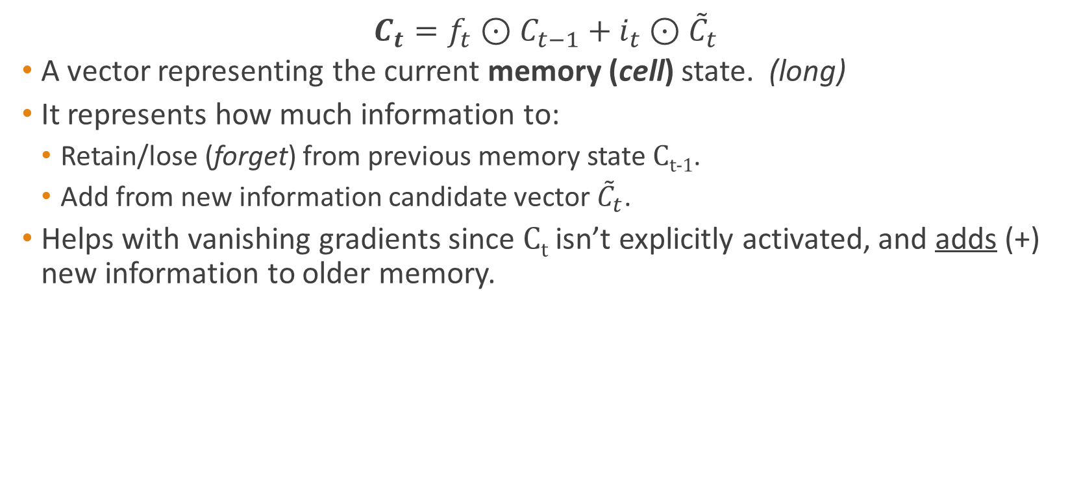
Long Short Term Memory (LSTM)
$$C_{t}=f_{t}⊙C_{t−1}+i_{t}⊙{\tilde{C}}_{t}$$
A vector representing the current memory (cell) state. (long)
It represents how much information to:
Retain/lose (forget) from previous memory state C_{t-1}.
Add from new information candidate vector ${\tilde{C}}_{t}$.
Helps with vanishing gradients since C_{t} isn’t explicitly activated, and adds (+) new information to older memory.

Slide 16

Long Short Term Memory (LSTM)
Forget gate: $f_{t}=σ\left(x_{t}U^{f}+h_{t−1}W^{f}\right)$
A vector of values in range (0,1) determining how much information to lose (forget) from each coordinate in C_{t-1} (previous cell state), given x_{t} (current input) and h_{t-1} (previous hidden state).
U^{f} and W^{f} are weight matrices which are learned during training.

Slide 17

Long Short Term Memory (LSTM)
$${\tilde{C}}_{t}=tanh(x_{t}U^{\tilde{C}}+h_{t−1}W^{\tilde{C}})$$
A vector containing new information (candidate) we would like to add to C_{t} (current cell state) given our previous hidden state h_{t-1} and current input x_{t}.
The input gate manipulates this vector.
U^{C} and W^{C} are weight matrices which are learned during training.

Slide 18
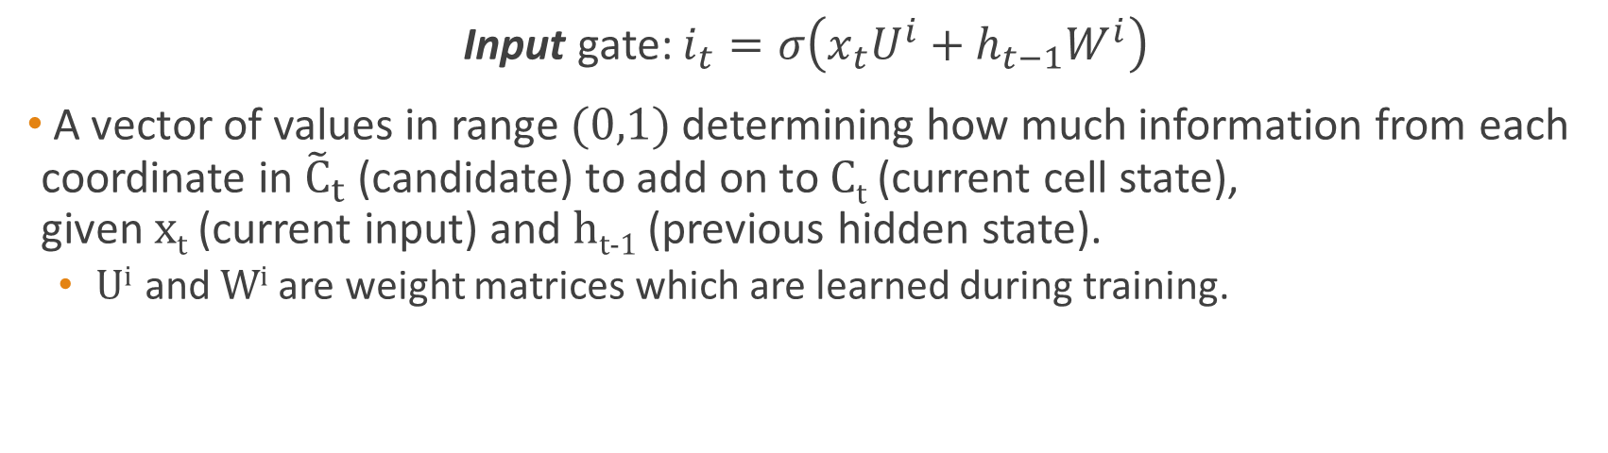
Long Short Term Memory (LSTM)
Input gate: $i_{t}=σ\left(x_{t}U^{i}+h_{t−1}W^{i}\right)$
A vector of values in range (0,1) determining how much information from each coordinate in ${\tilde{C}}_{t}$ (candidate) to add on to C_{t} (current cell state), given x_{t} (current input) and h_{t-1} (previous hidden state).
U^{i} and W^{i} are weight matrices which are learned during training.

Slide 19

Long Short Term Memory (LSTM)
$$h_{t}=o_{t}⊙tanh\left(C_{t}\right)$$
A vector representing the current hidden state. (short)
It represents how much information to:
Copy from current cell state C_{t} and expose as output.
Retain for internal memory state propagation, and gate calculations.

Slide 20

Long Short Term Memory (LSTM)
Output gate: $o_{t}=σ\left(x_{t}U^{o}+h_{t−1}W^{o}\right)$
A vector of values in range (0,1) determining how much information to copy from C_{t} (current cell state) to the current hidden state (per coordinate), given x_{t} (current input) and h_{t-1} (previous hidden state)
Uº and Wº are weight matrices which are learned during training.

Slide 21
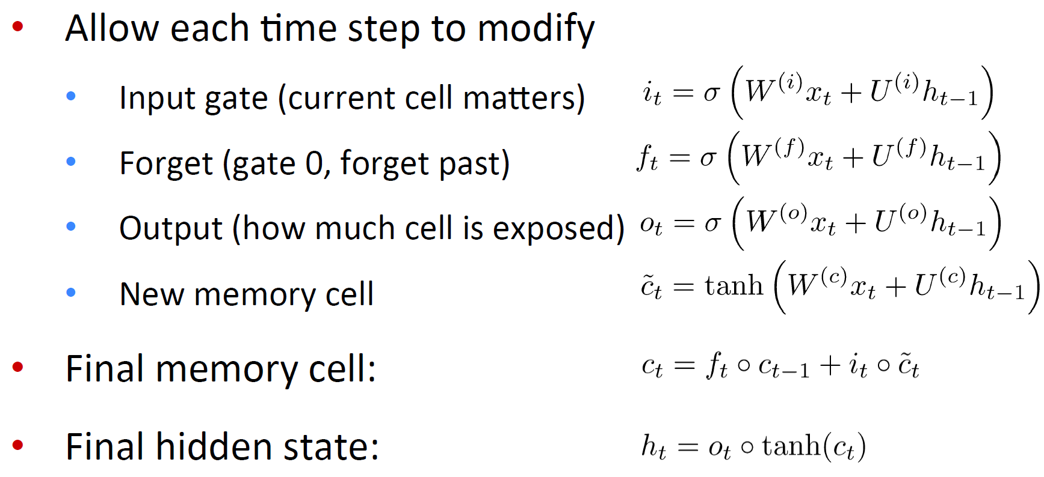
Long Short Term Memory (LSTM)

